Slide 1
Students Performance Analysis
Insights and Trends from the Students Grading Dataset

Slide 2
Objective: Analyze student performance data to uncover insights and improve academic outcomes. Dataset Overview: Contains information on demographics, academic performance, study habits, and external factors. Key Columns: Gender, Age, Department, Attendance, Midterm_Score, Final_Score, etc.

Slide 3
Data Exploration
Dataset Shape: 5000 rows, 23 columns.
Missing Values Handling: Filled missing values in 'Attendance (%)', 'Assignments_Avg', and 'Parent_Education_Level' with median and mode.

Slide 4
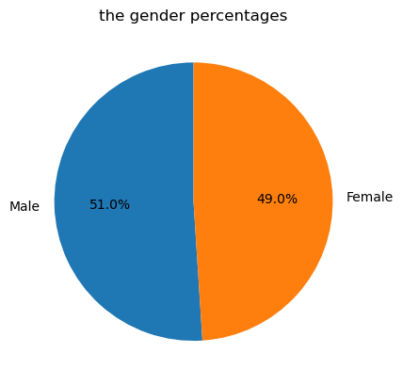
Gender Distribution
Almost equal distribution of males and females.

Slide 5
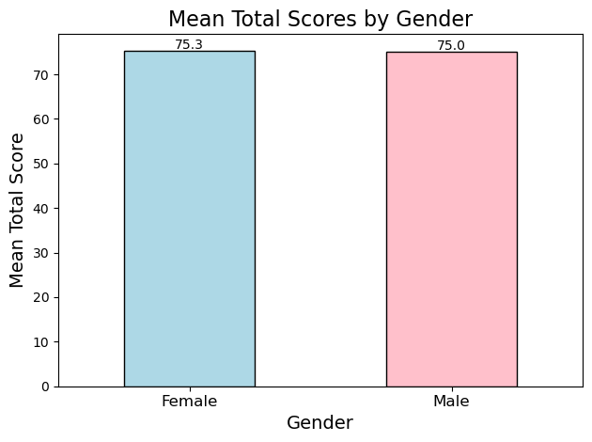
Gender…..

Slide 6
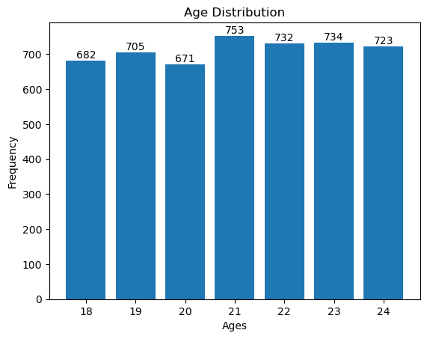
Age Distribution
Uniform distribution of ages between 18 and 24.

Slide 7
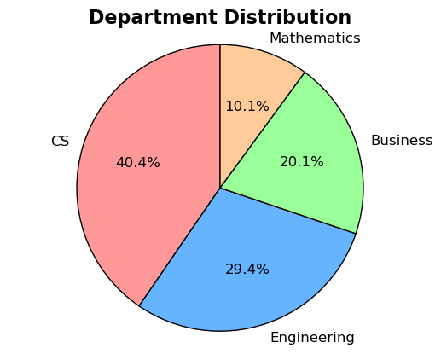
Department Percentages
69.4% of the university is studying computer science and studying engineering the most of of sutdents

Slide 8
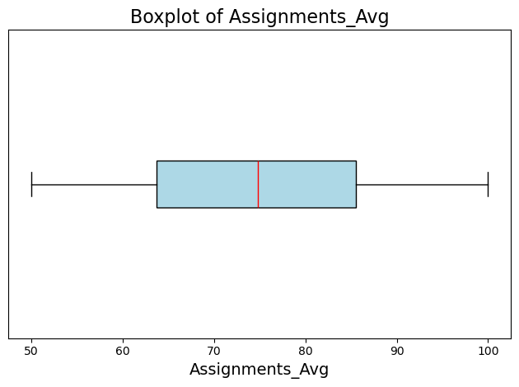
Detecting Outlayers of Assignment
The is no outlayer

Slide 9
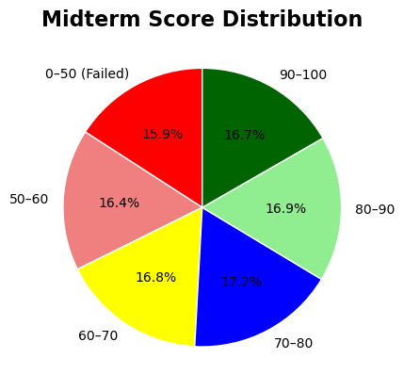
Mid-Term
There are 795 students who failed and 835 got A+ in the midterm exam that means the exam was moderate

Slide 10
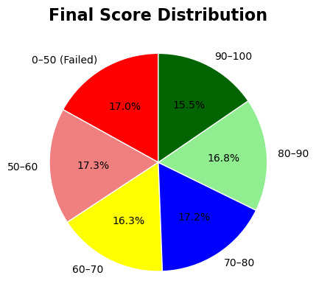
Final Score
there are 850 student failed and 865 got from 50:60 that mens the final exam was diffecult

Slide 11
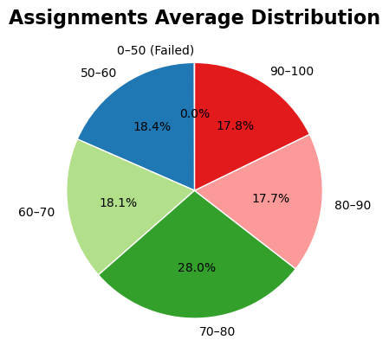
Assignments
there are no failers and from the percentages that shows the assignments were easy

Slide 12
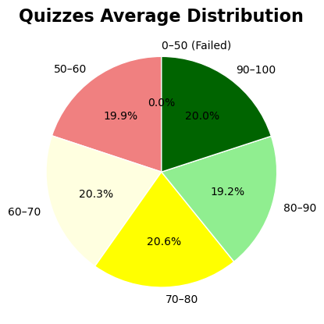
Quizzes
no failers and 999 students got from 50:60 and 1000 got A+ the quizes were moderat

Slide 13
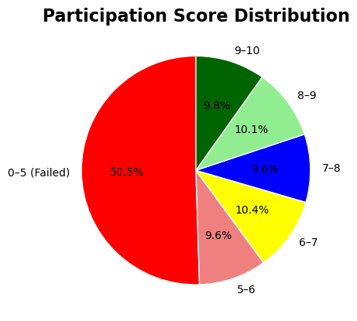
Participation
2750 student got less than the half degrees on the participation that would mean the lectures board and not interactive

Slide 14
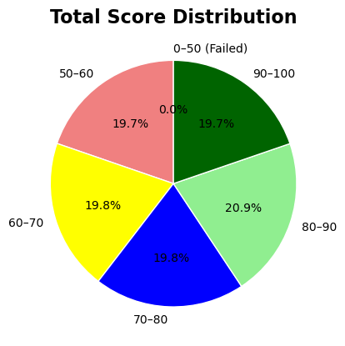
Total Score
no failers 3020 students got grades from 70:100 the overall is good grades

Slide 15
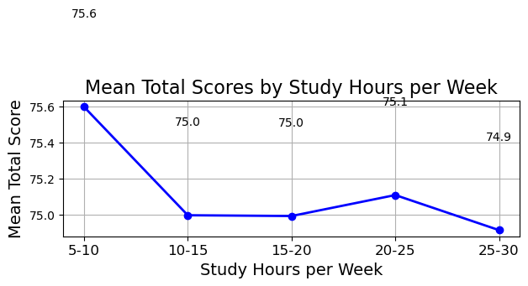
Total Scores by Study Hours per Week
there is no relation between Study_Hours_per_Week and the grades data says that

Slide 16
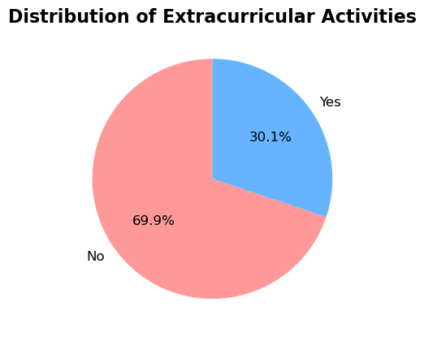
Extracurricular Activities

Slide 17
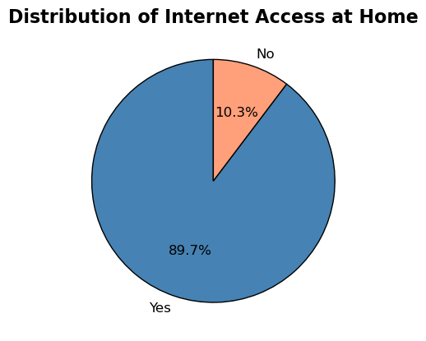
Internet Access at Home

Slide 18
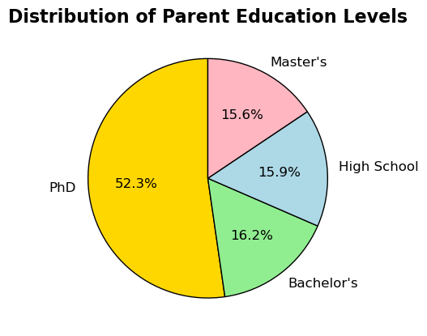
Parent Education Levels

Slide 19
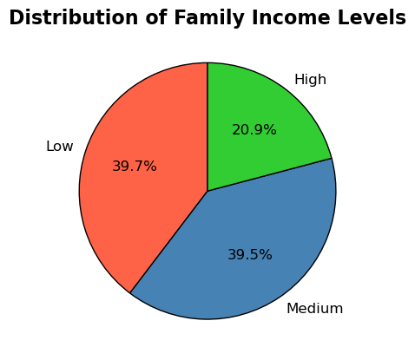
Family Income Levels

Slide 20
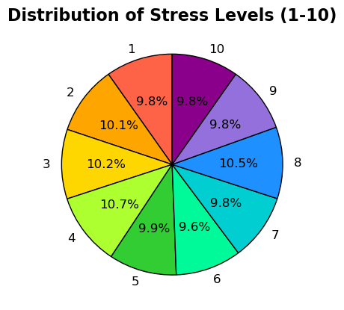
Stress Levels

Slide 21
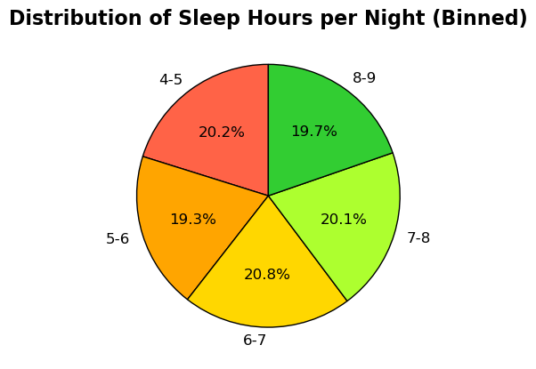
Sleep Hours per Night

Slide 22
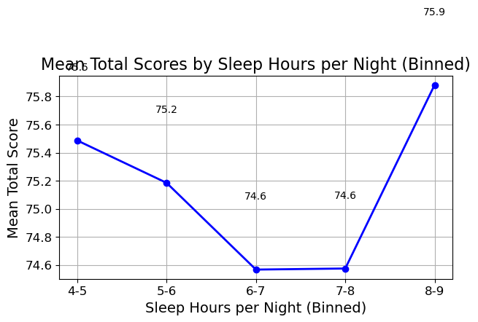
Sleep Hours per Night …..

Slide 23
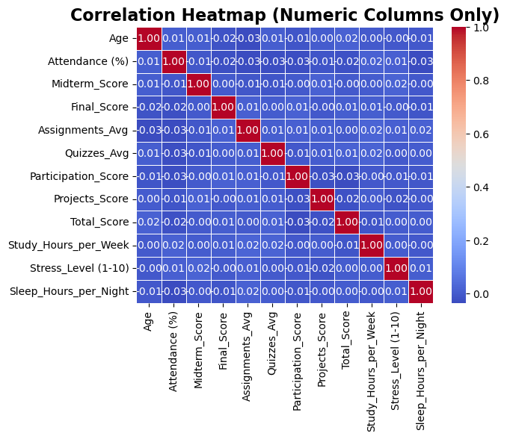
Correlation Heatmap

Slide 24
Summary of Findings
Midterm Exam:
The midterm exam was of moderate difficulty. Some students failed, some passed with low grades, and others achieved average scores with decent percentages. Therefore, the exam was moderately difficult, leaning towards being challenging. It is recommended to reduce its difficulty and investigate the reasons why some students did not pass this exam.

Slide 25
Summary of Findings
Final Exam:
The final exam was difficult because many students did not pass it, and a significant number also did not achieve good grades.
Assignments:
All students passed the assignments, which either indicates that they were easy or that cheating occurred since they were unsupervised as they were completed at home.

Slide 26
Summary of Findings
Quizzes:
All students passed the quizzes, and a large percentage scored above 70%, indicating that they were easy.
Participation in Lectures:
Participation in lectures was very low. We need to investigate this issue to uncover the reason. It could be due to boring lectures, students not being fully focused during the sessions, or any other factor.
Overall:
The students' grades follow a uniform distribution.

Slide 27
Thank You

